Slide 1
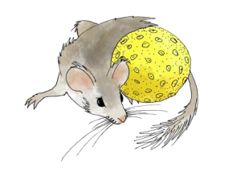

American Quaternary Association
Santa Fe, New Mexico, June 29-July 1, 2016
The Neotoma Paleoecology Database:
Community-led Cyberinfrastructure for
Global Change Research
(www.neotomadb.org)
Eric C. Grimm, University of Minnesota
Allan C. Ashworth, North Dakota State University
Brian Bills, Pennsylvania State University
Jessica Blois, University of California Merced
Donald F. Charles, Drexel University
Simon J. Goring, University of Wisconsin Madison
Russell W. Graham, Pennsylvania State University
Alison J. Smith, Kent State University
John (Jack) W. Williams, University of Wisconsin Madison
NEOTOMA DATABASE CONSORTIUM LEADERS
Geoinformatics Program

Slide 2
Q: What is Neotoma?
A: An Open-Access Multiproxy Community Database for the Quaternary-Pliocene

Slide 3
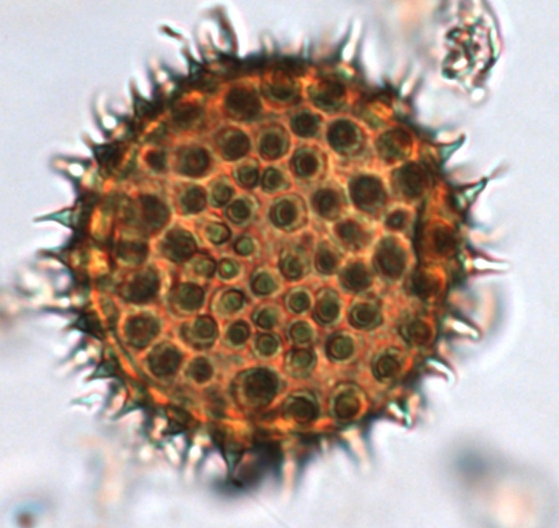
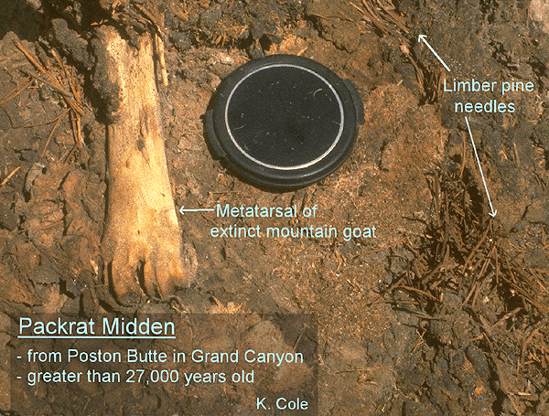
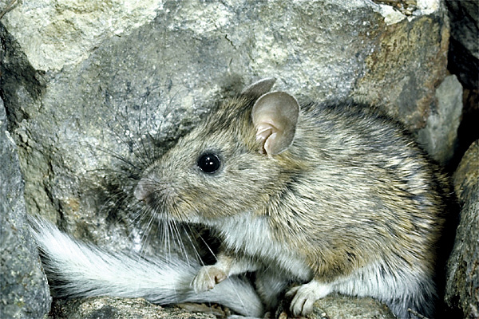
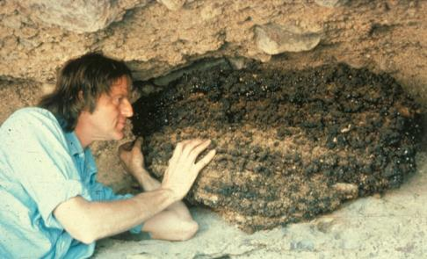
Q: Whence Neotoma?
A: Named for the packrat (Neotoma), a multiproxy data collector.

Slide 4
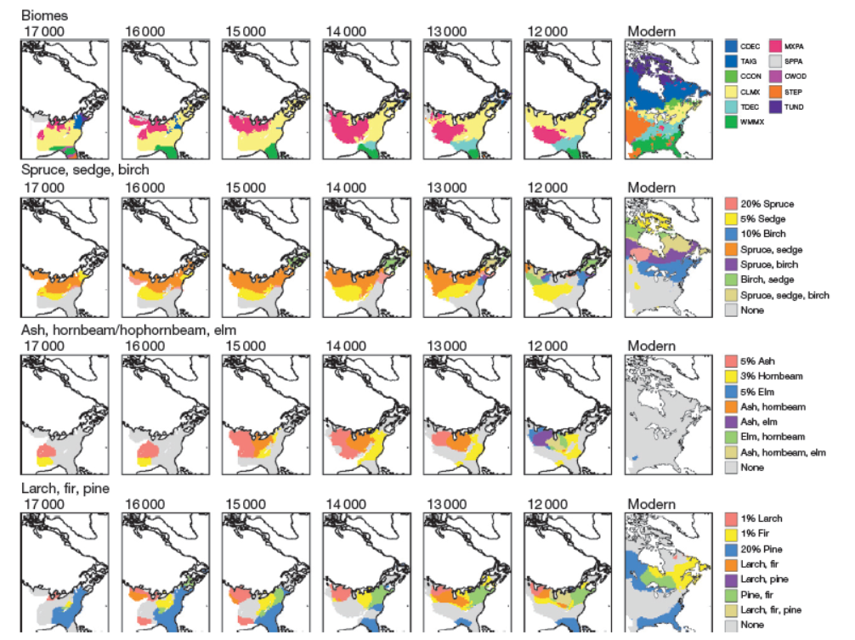
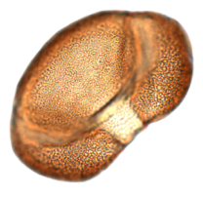
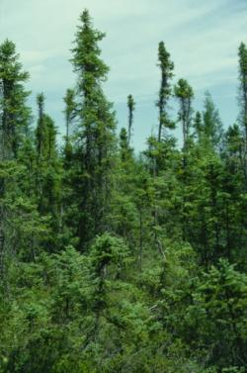
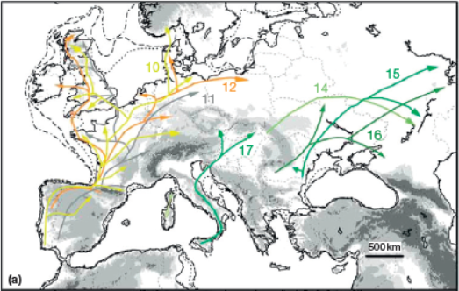
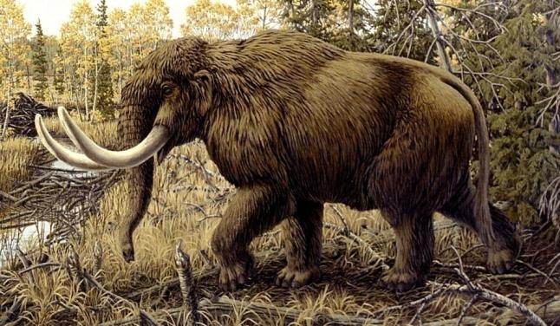
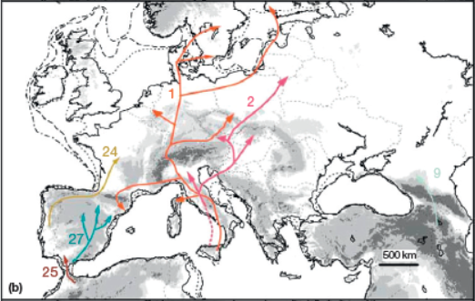
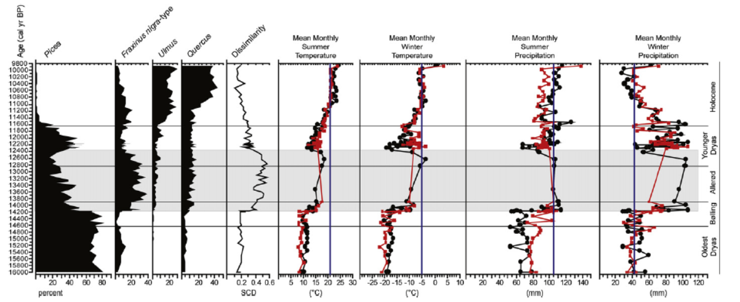
Purposes of Neotoma
To facilitate studies of ecosystem development and response to climate change
To enable joint analysis of multiproxy datasets to address paleoenvironmental questions that transcend those possible with single-proxy databases.
To provide the historical context for understanding biodiversity dynamics, including genetic diversity
To provide the data for climate-model validation
To facilitate analyses of biostratigraphy
To provide a safe, long-term, low-cost archive for a wide variety of paleobiological data
To lower the overall cost of paleodata management
To meet data management, data sharing, and archival requirements of funding agencies, institutions, and journals.
inferred postglacial colonization routes for frequent cpDNA haplotypes of deciduous Quercus. (Petit et al. 2002)
Representations of late Pleistocene and modern plant associations as biomes (top row) and as multitaxon isopoll maps (rows 2–4). Williams et al. (2001)
Gonzales et al. (2009)

Slide 5
U.S. National Science Foundation
Award and Administration Guide
4. Dissemination and Sharing of Research Results
a. Investigators are expected to promptly prepare and submit for publication, with authorship that accurately reflects the contributions of those involved, all significant findings from work conducted under NSF grants. Grantees are expected to permit and encourage such publication by those actually performing that work, unless a grantee intends to publish or disseminate such findings itself.
b. Investigators are expected to share with other researchers, at no more than incremental cost and within a reasonable time, the primary data, samples, physical collections and other supporting materials created or gathered in the course of work under NSF grants. Grantees are expected to encourage and facilitate such sharing. Privileged or confidential information should be released only in a form that protects the privacy of individuals and subjects involved. General adjustments and, where essential, exceptions to this sharing expectation may be specified by the funding NSF Program or Division/Office for a particular field or discipline to safeguard the rights of individuals and subjects, the validity of results, or the integrity of collections or to accommodate the legitimate interest of investigators. A grantee or investigator also may request a particular adjustment or exception from the cognizant NSF Program Officer.
c. Investigators and grantees are encouraged to share software and inventions created under the grant or otherwise make them or their products widely available and usable.
d. NSF normally allows grantees to retain principal legal rights to intellectual property developed under NSF grants to provide incentives for development and dissemination of inventions, software and publications that can enhance their usefulness, accessibility and upkeep. Such incentives do not, however, reduce the responsibility that investigators and organizations have as members of the scientific and engineering community, to make results, data and collections available to other researchers.
e. NSF program management will implement these policies for dissemination and sharing of research results, in a way appropriate to field and circumstances, through the proposal review process; through award negotiations and conditions; and through appropriate support and incentives for data cleanup, documentation, dissemination, storage and the like.
4. Dissemination and Sharing of Research Results
a. Investigators are expected to promptly prepare and submit for publication, with authorship that accurately reflects the contributions of those involved, all significant findings from work conducted under NSF grants. Grantees are expected to permit and encourage such publication by those actually performing that work, unless a grantee intends to publish or disseminate such findings itself.
b. Investigators are expected to share with other researchers, at no more than incremental cost and within a reasonable time, the primary data, samples, physical collections and other supporting materials created or gathered in the course of work under NSF grants. Grantees are expected to encourage and facilitate such sharing. Privileged or confidential information should be released only in a form that protects the privacy of individuals and subjects involved. General adjustments and, where essential, exceptions to this sharing expectation may be specified by the funding NSF Program or Division/Office for a particular field or discipline to safeguard the rights of individuals and subjects, the validity of results, or the integrity of collections or to accommodate the legitimate interest of investigators. A grantee or investigator also may request a particular adjustment or exception from the cognizant NSF Program Officer.
c. Investigators and grantees are encouraged to share software and inventions created under the grant or otherwise make them or their products widely available and usable.
d. NSF normally allows grantees to retain principal legal rights to intellectual property developed under NSF grants to provide incentives for development and dissemination of inventions, software and publications that can enhance their usefulness, accessibility and upkeep. Such incentives do not, however, reduce the responsibility that investigators and organizations have as members of the scientific and engineering community, to make results, data and collections available to other researchers.
e. NSF program management will implement these policies for dissemination and sharing of research results, in a way appropriate to field and circumstances, through the proposal review process; through award negotiations and conditions; and through appropriate support and incentives for data cleanup, documentation, dissemination, storage and the like.
b. Investigators are expected to share with other researchers, at no more than incremental cost and within a reasonable time, the primary data, samples, physical collections and other supporting materials created or gathered in the course of work under NSF grants. Grantees are expected to encourage and facilitate such sharing.

Slide 6
U.S. National Science Foundation
Grant Proposal Guide
Plans for data management and sharing of the products of research. Proposals must include a supplementary document of no more than two pages labeled "Data Management Plan". This supplementary document should describe how the proposal will conform to NSF policy on the dissemination and sharing of research results (see AAG Chapter VI.D.4), and may include:
the types of data, samples, physical collections, software, curriculum materials, and other materials to be produced in the course of the project;
the standards to be used for data and metadata format and content (where existing standards are absent or deemed inadequate, this should be documented along with any proposed solutions or remedies);
policies for access and sharing including provisions for appropriate protection of privacy, confidentiality, security, intellectual property, or other rights or requirements;
policies and provisions for re-use, re-distribution, and the production of derivatives; and
plans for archiving data, samples, and other research products, and for preservation of access to them.
Plans for data management and sharing of the products of research. Proposals must include a supplementary document of no more than two pages labeled "Data Management Plan". This supplementary document should describe how the proposal will conform to NSF policy on the dissemination and sharing of research results (see AAG Chapter VI.D.4), and may include:
the types of data, samples, physical collections, software, curriculum materials, and other materials to be produced in the course of the project;
the standards to be used for data and metadata format and content (where existing standards are absent or deemed inadequate, this should be documented along with any proposed solutions or remedies);
policies for access and sharing including provisions for appropriate protection of privacy, confidentiality, security, intellectual property, or other rights or requirements;
policies and provisions for re-use, re-distribution, and the production of derivatives; and
plans for archiving data, samples, and other research products, and for preservation of access to them.

Slide 7
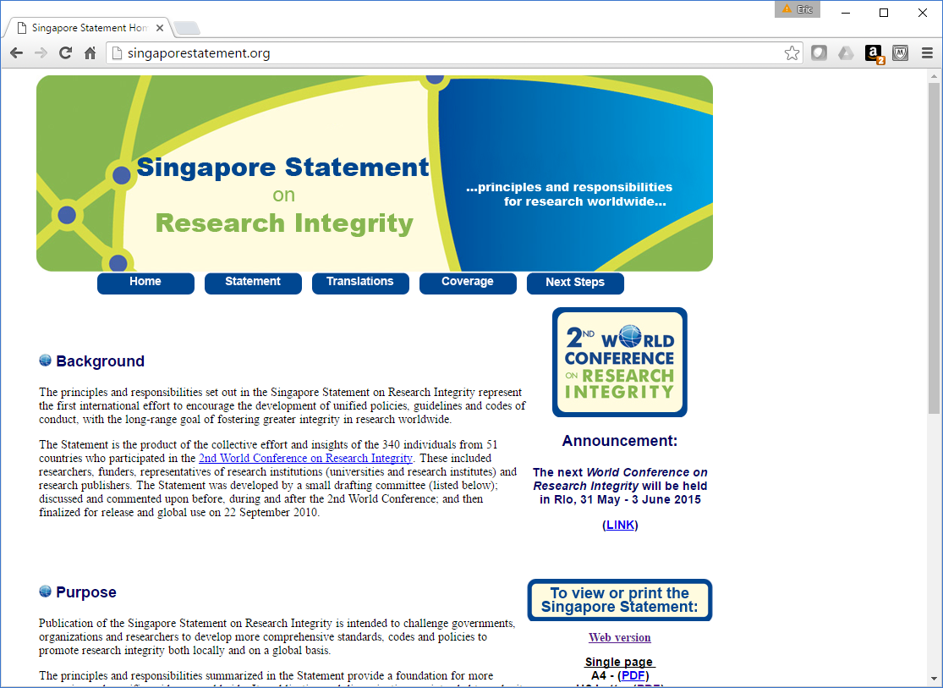
International: Singapore Statement on Research Integrity

Slide 8
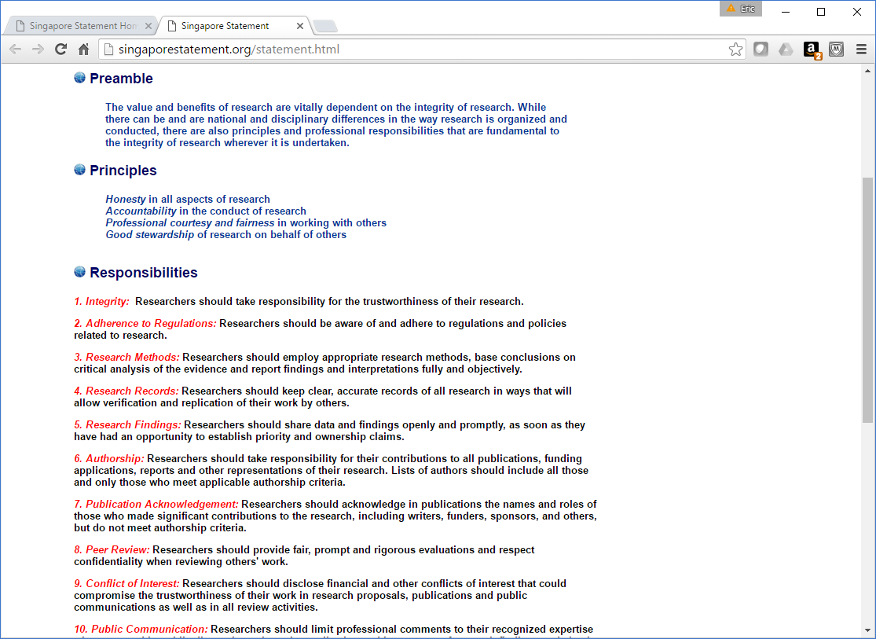
International: Singapore Statement on Research Integrity
5. Research Findings: Researchers should share data and findings openly and promptly, as soon as they have had an opportunity to establish priority and ownership claims.

Slide 9
Neotoma Design Concepts
Partnership between domain scientists and information technology specialists; wherein the science is driving the IT.
Neotoma offers database infrastructure to specialists in various taxonomic groups, who will not need to develop or even necessarily understand the core information technology, but who can learn to input, update, and extract data through a user-friendly interface and to have control over disciplinary taxonomic issues.
Neotoma can accommodate virtually any type of fossil data
Neotoma is a centralized database with virtual constituent databases (e.g. North American Pollen Database, FAUNMAP)
Constituent database cooperatives may develop individualized websites to frontend the database if they so desire
Capability for “data stewards” to remotely input and update data
Access to the data by anyone with an Internet connection

Slide 10
Neotoma Data Policies
Although Neotoma data are, in general, open access, data users are expected to abide by rules for attribution, citation, and co-authorship.
Data Use Policy
Embargo Policy
Contribution of new and unpublished datasets to Neotoma prior to first publication
Preparation and uploading of previously published datasets to Neotoma by data synthesizers

Slide 11
Neotoma Constituent Databases
Academy of Natural Sciences of Drexel University (Diatoms)
African Pollen Database
Alaskan Archaeofaunas
ANTIGUA
Canadian Pollen Database
Chinese Pollen Database
European Pollen Database
FAUNMAP
French Institute of Pondicherry Palynology and Paleoecology Database
Holocene Perspective on Peatland Biogeochemistry
Neotoma
North American Non-Marine Ostracode Database Project (NANODe)
Indo-Pacific Pollen Database
Japanese Pollen Database
Latin American Pollen Database
MioMap
Neotoma Midden Database
North American Plant Macrofossil Database
North American Pollen Database
North Dakota State University Insect Database
Pollen Database for Siberia and the Russian Far East

Slide 12


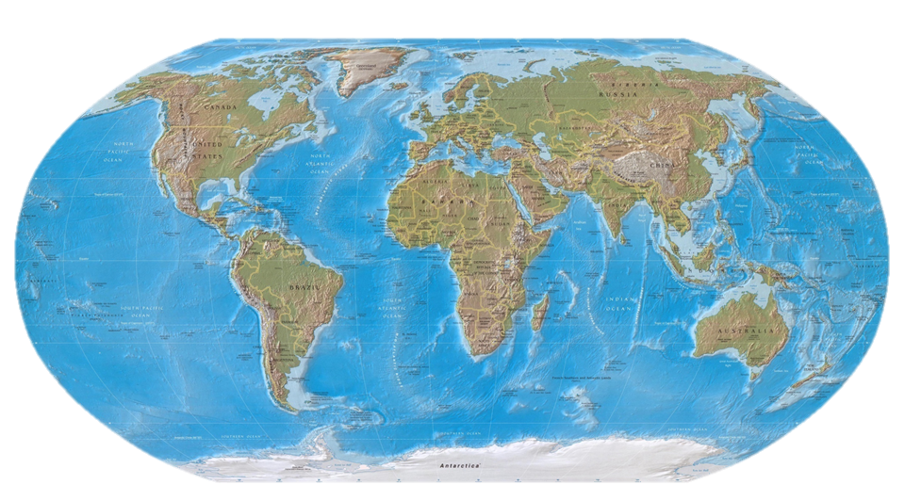
NEOTOMA: Data Stewards
Center for Environmental Informatics, Pennsylvania State University

Slide 13
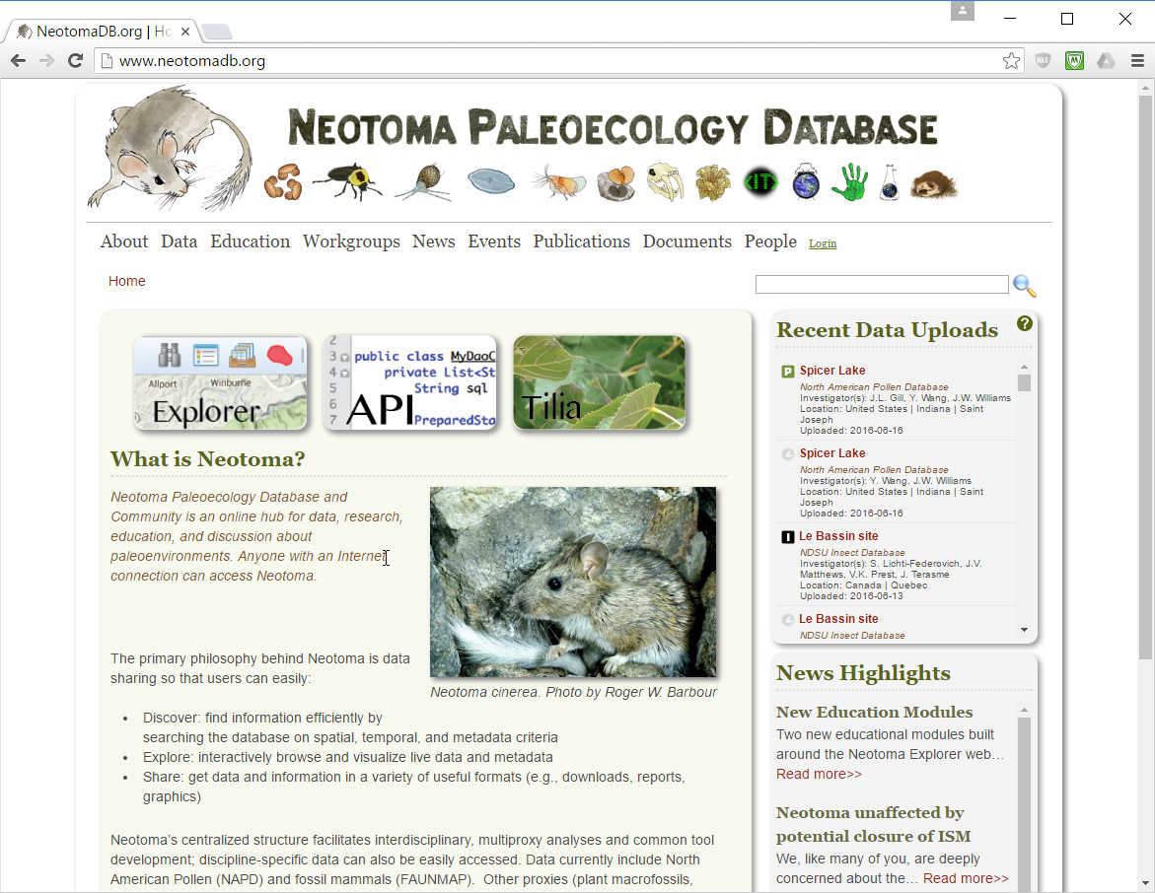
NEOTOMA Website: www.neotomadb.org

Slide 14
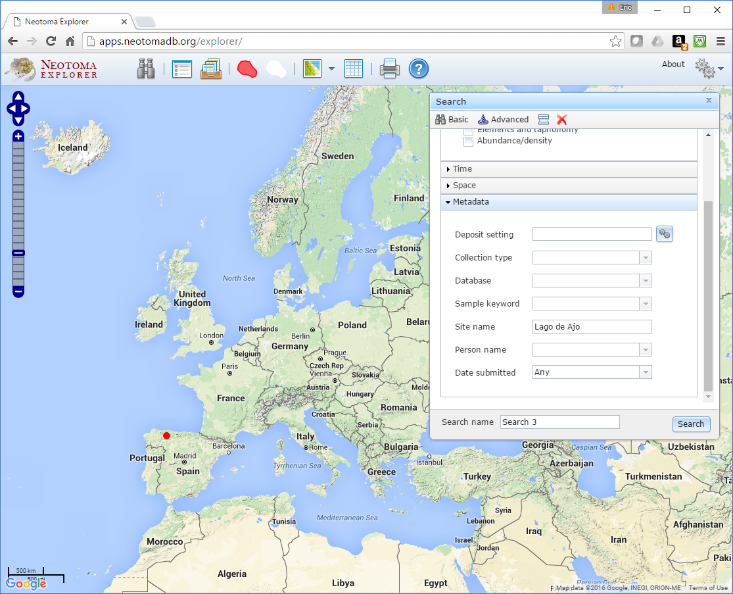
NEOTOMA Explorer

Slide 15
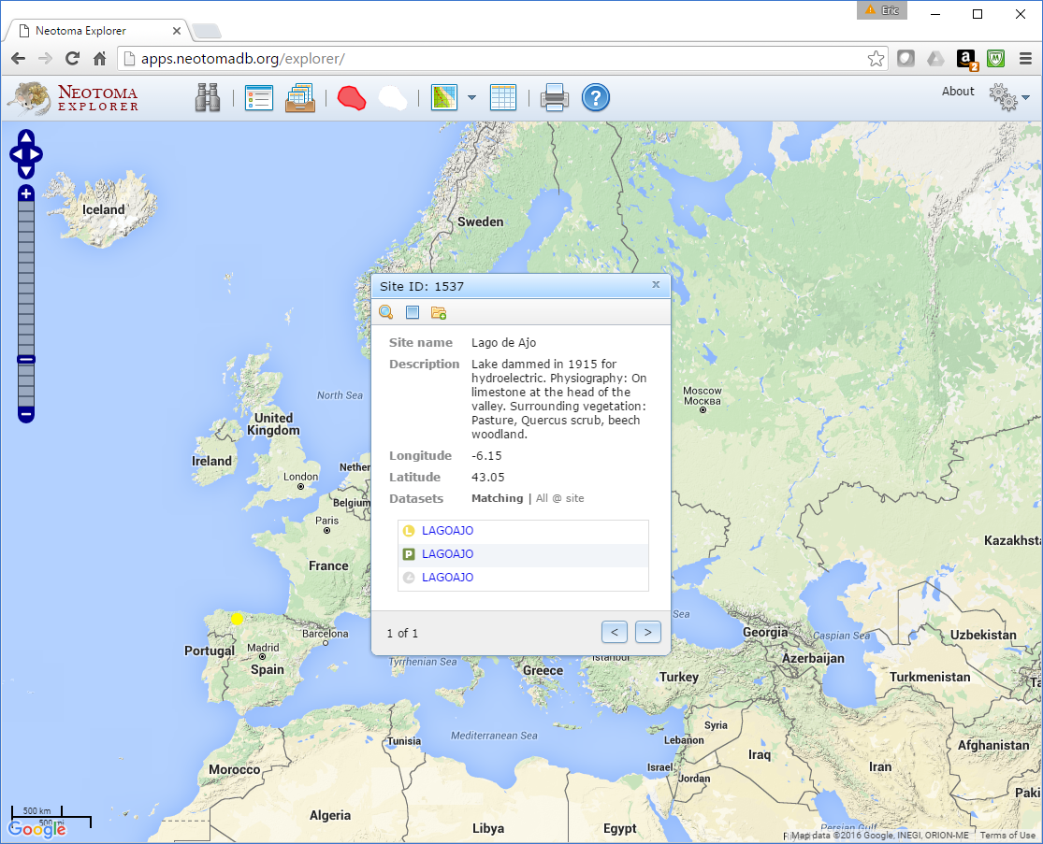
NEOTOMA Explorer

Slide 16
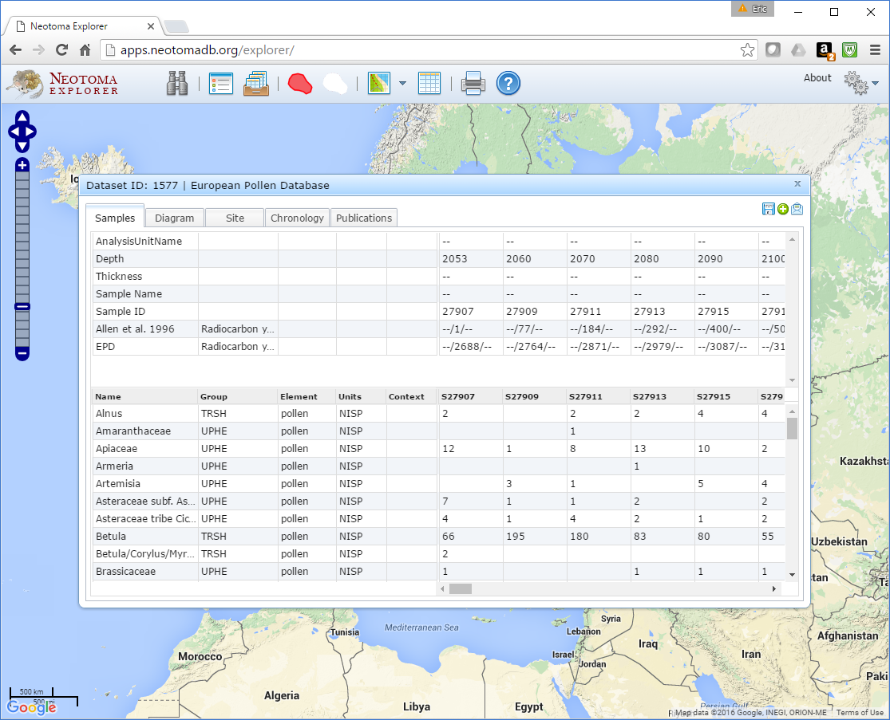
NEOTOMA Explorer

Slide 17
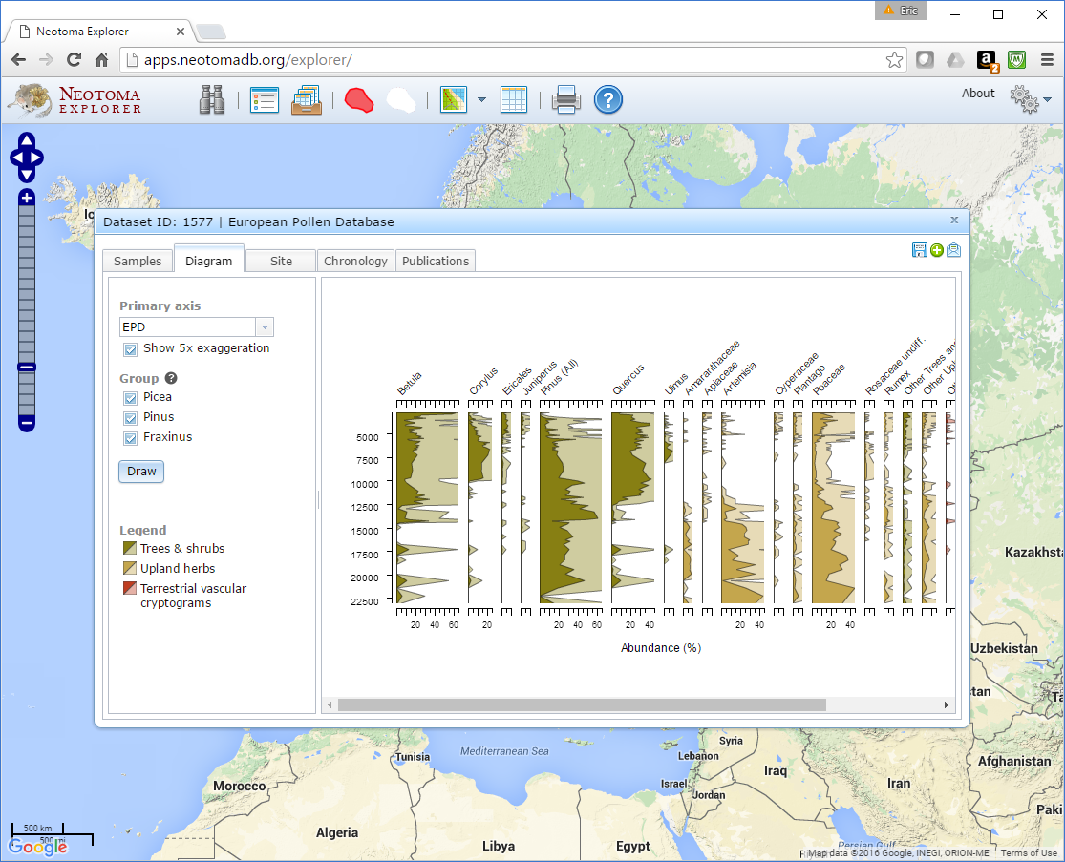
NEOTOMA Explorer

Slide 18
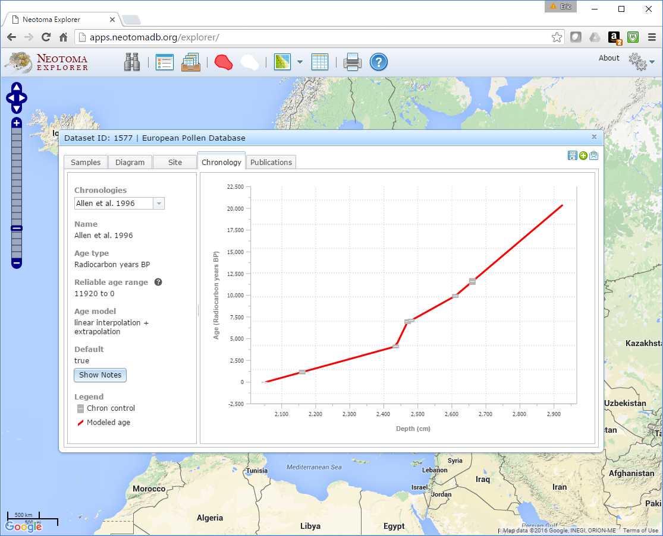
NEOTOMA Explorer

Slide 19
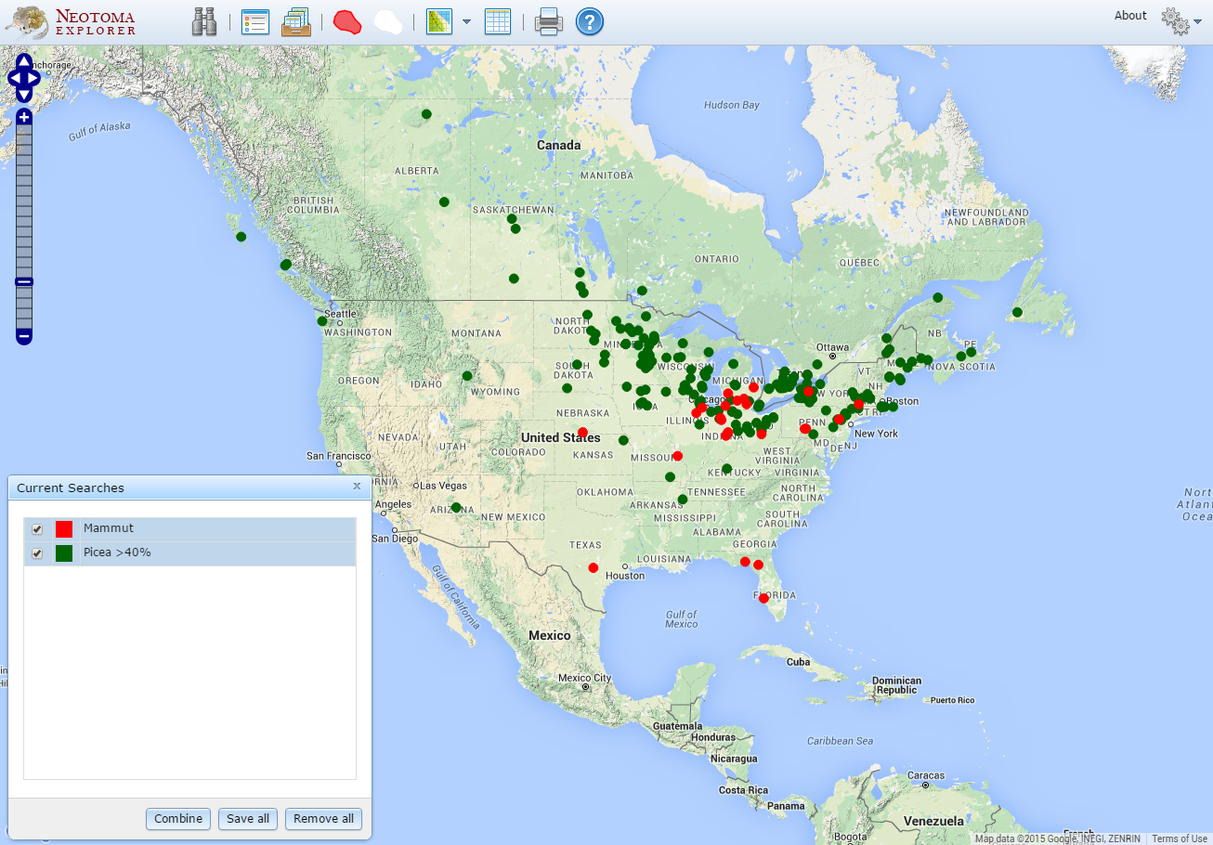
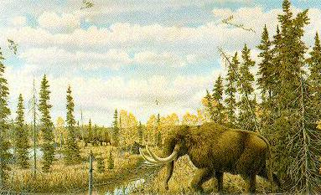
18-12 ka: >40% Picea, Mammut

Slide 20
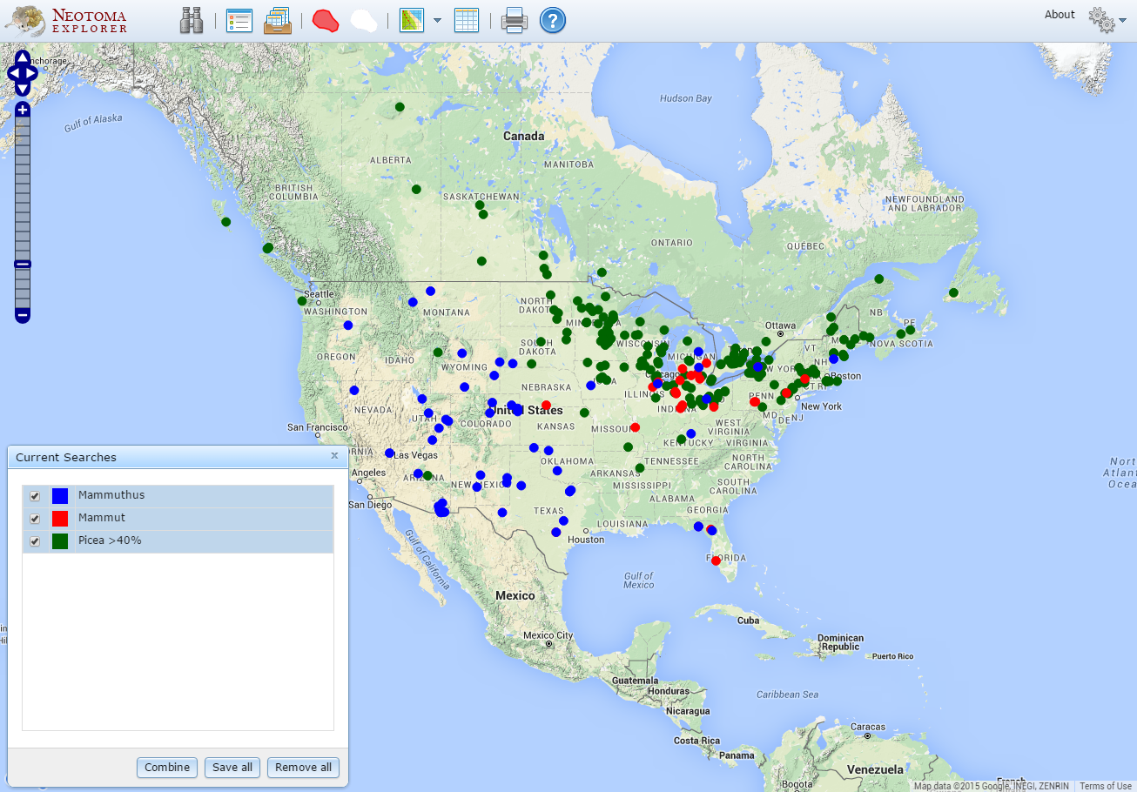
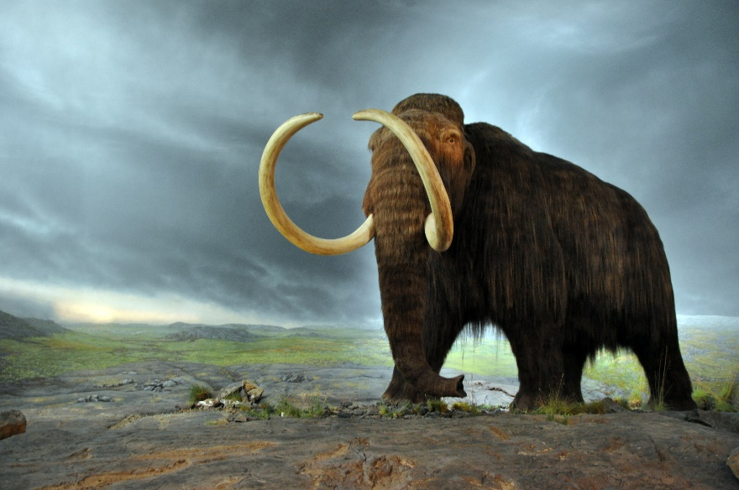
18-12 ka: >40% Picea, Mammut, Mammuthus
Critical issue is dating!

Slide 21
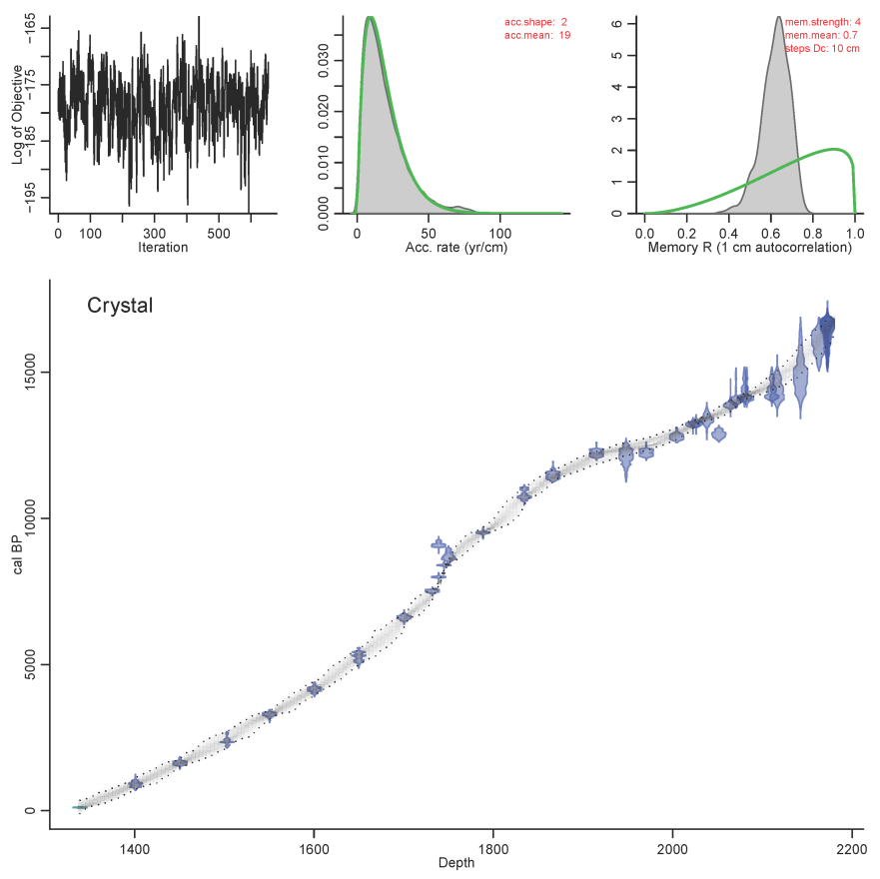
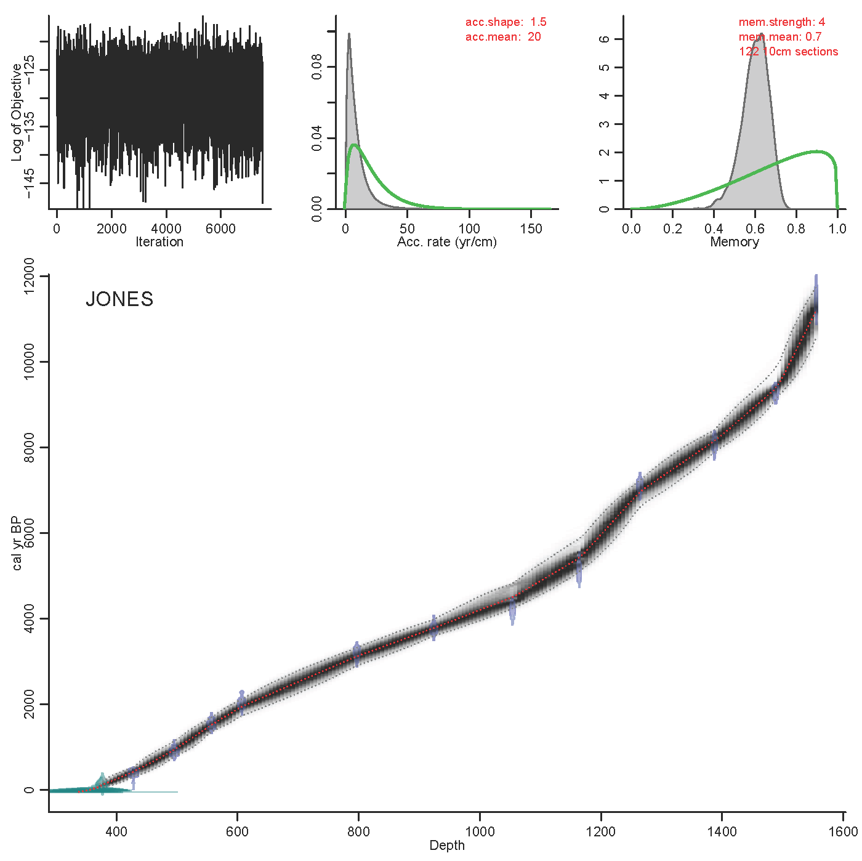
Value Added: Chronologies and Age Models

Slide 22
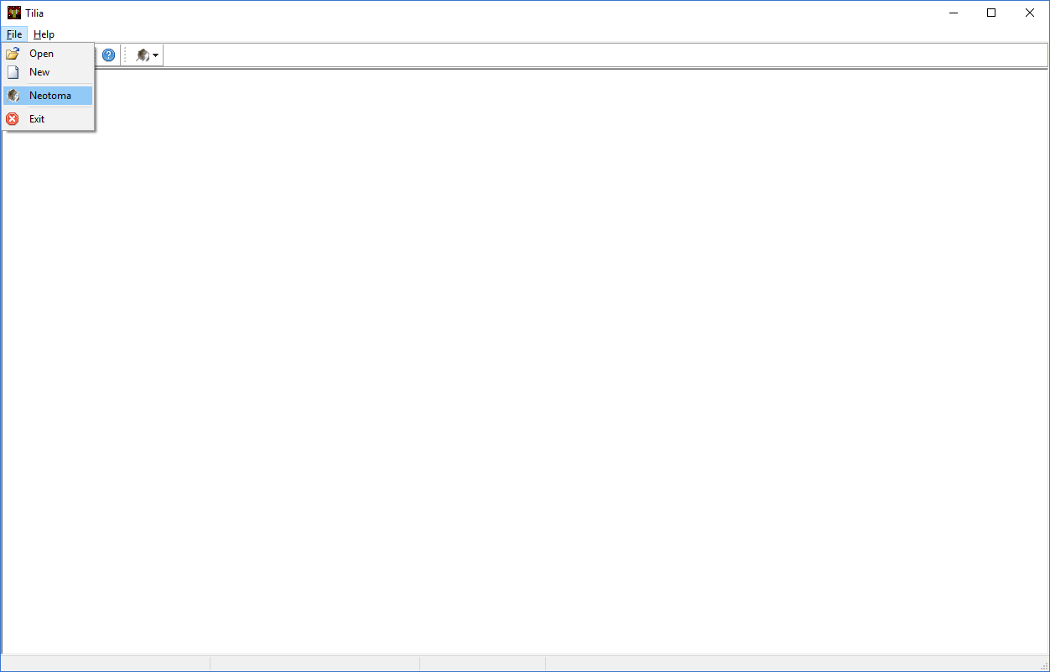
Tilia

Slide 23
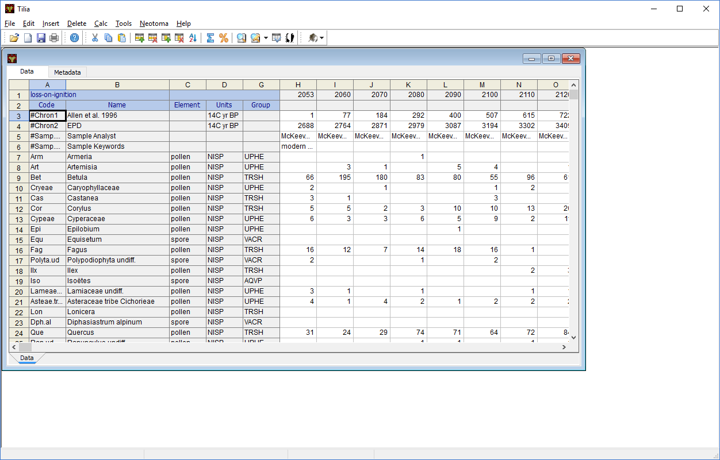
Tilia

Slide 24
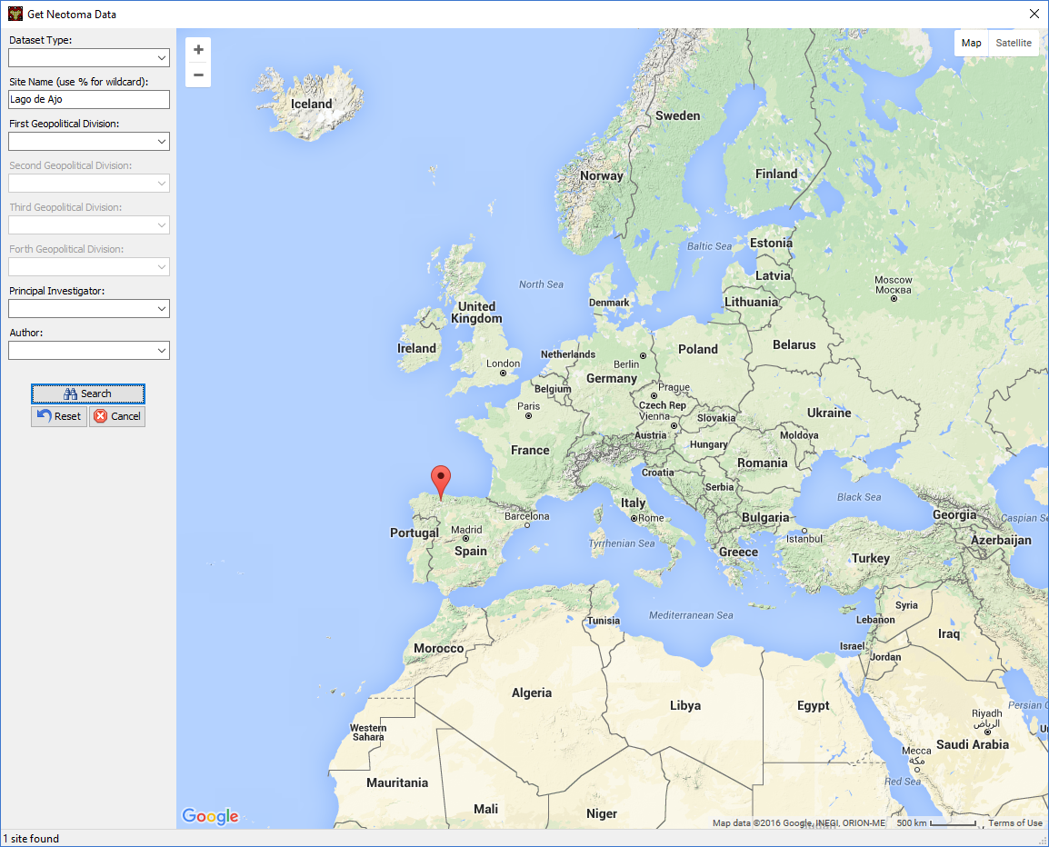
Tilia

Slide 25
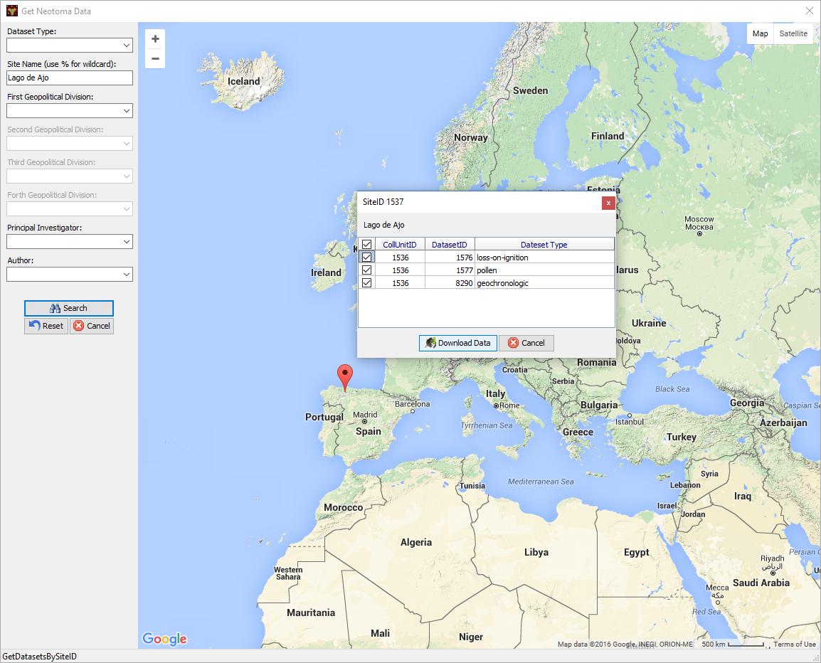
Tilia

Slide 26
Neotoma Application Programming Interface (API)

Slide 27
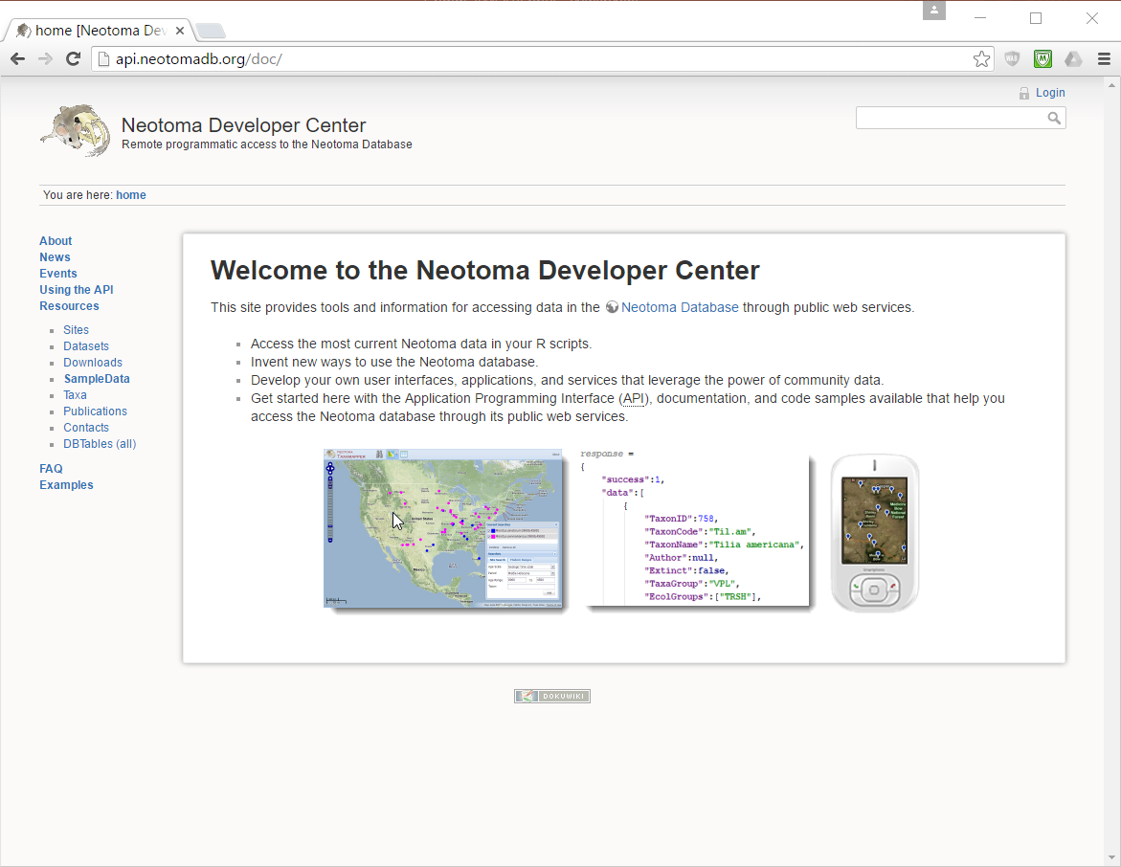
Neotoma Application Programming Interface (API)

Slide 28
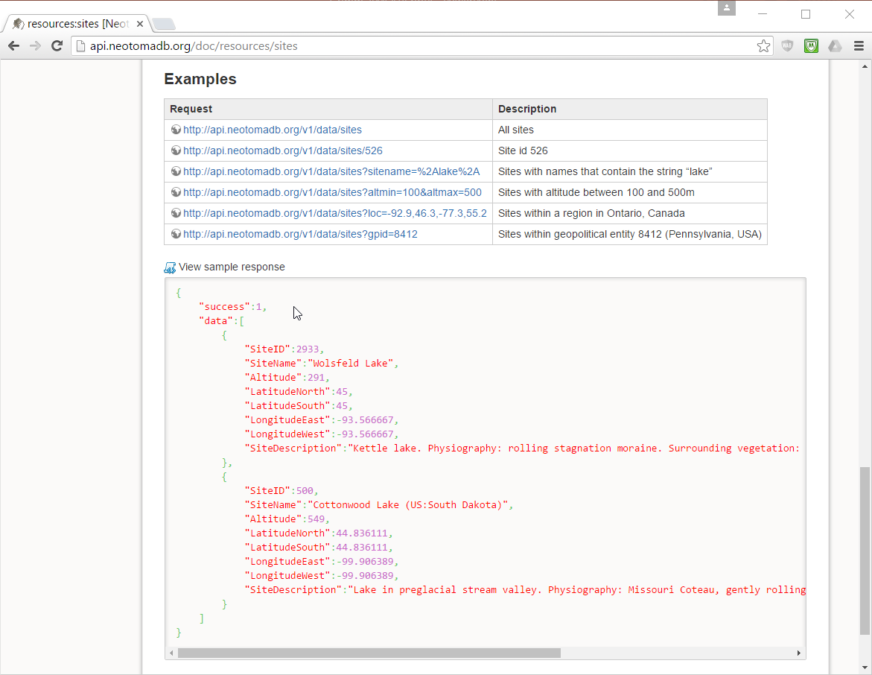
Neotoma Application Programming Interface (API)

Slide 29
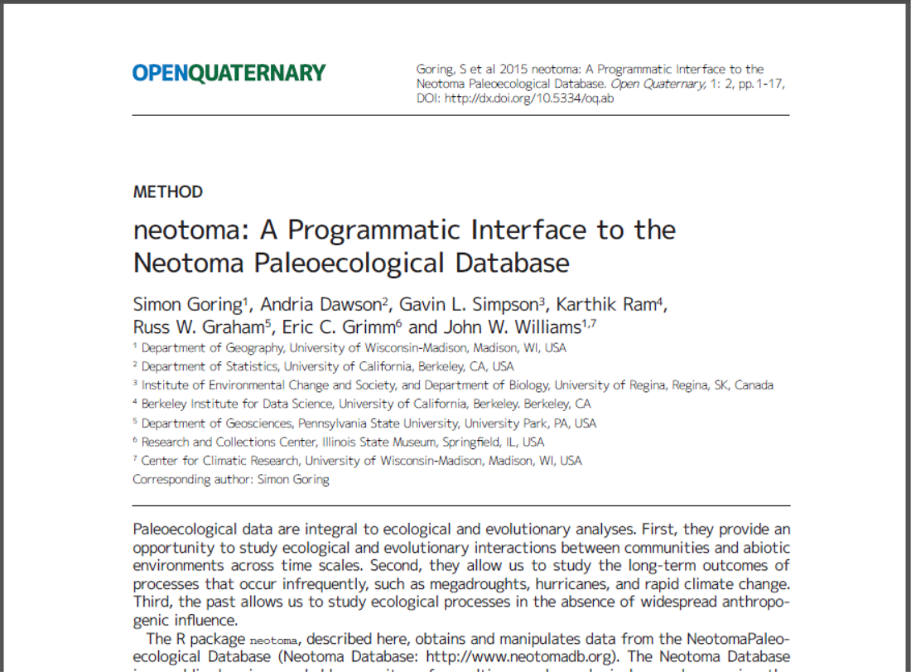
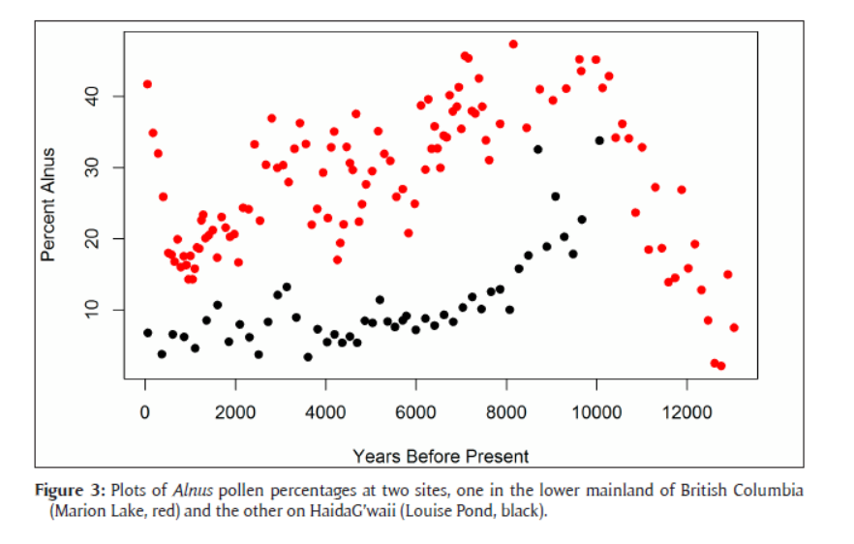
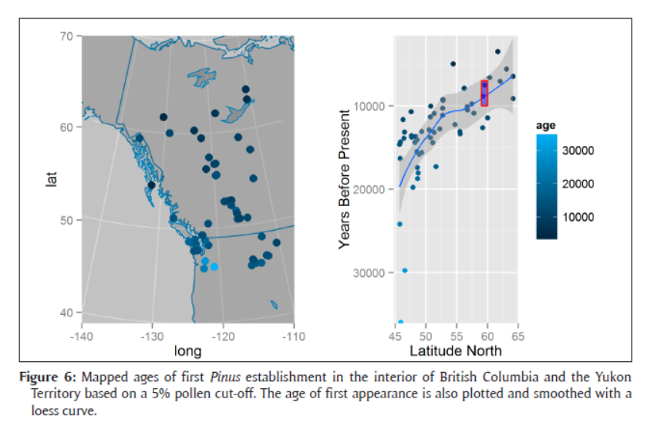
neotoma R package

Slide 30
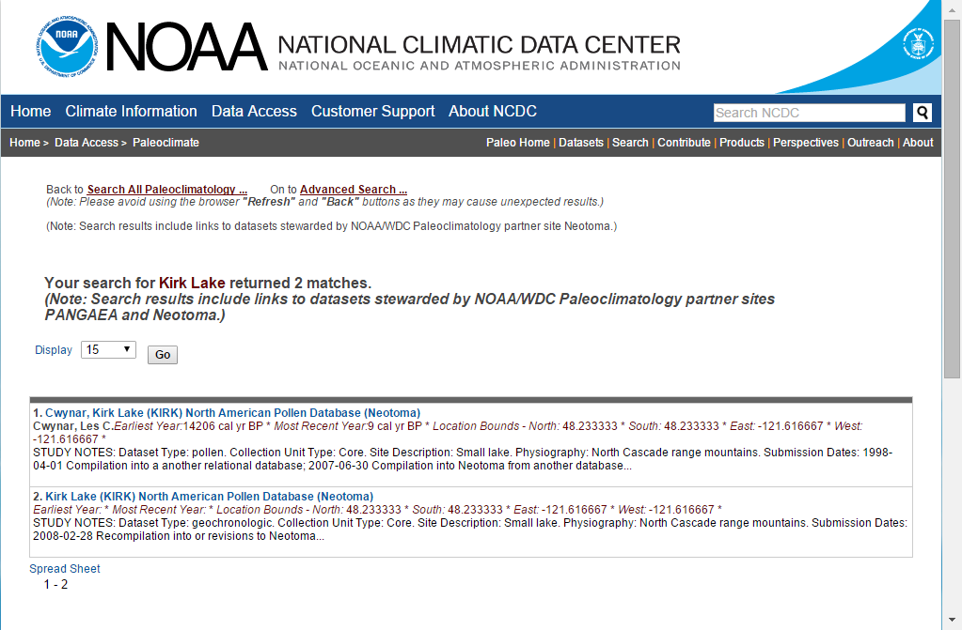
Neotoma Application Programming Interface (API)

Slide 31
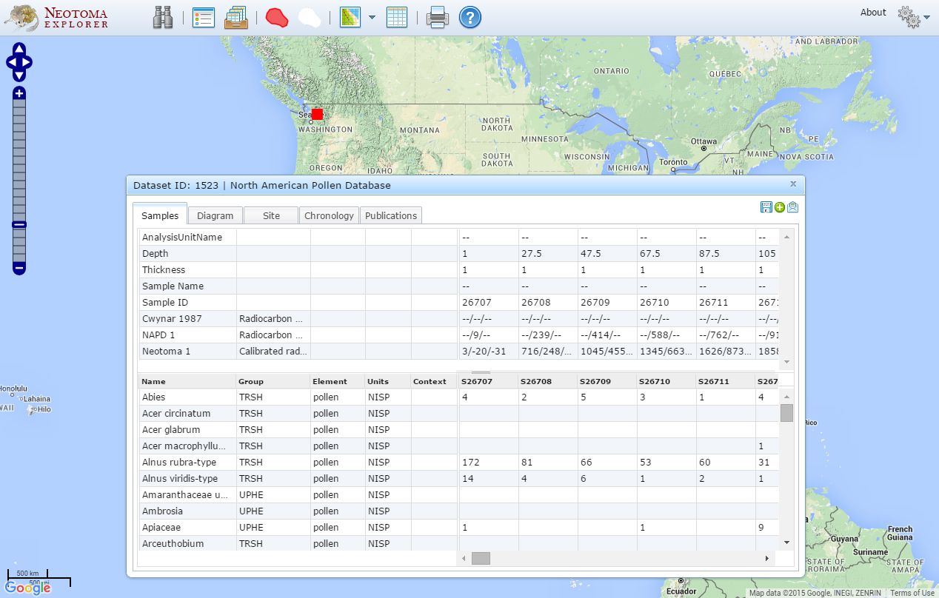
Neotoma Application Programming Interface (API)
http://apps.neotomadb.org/Explorer/?datasetid=1523

Slide 32
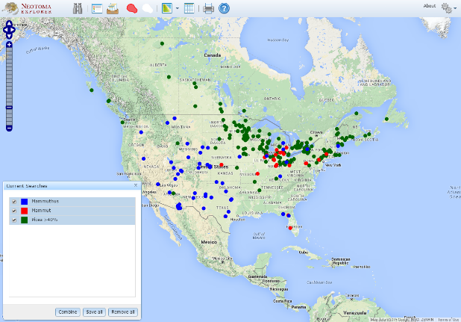
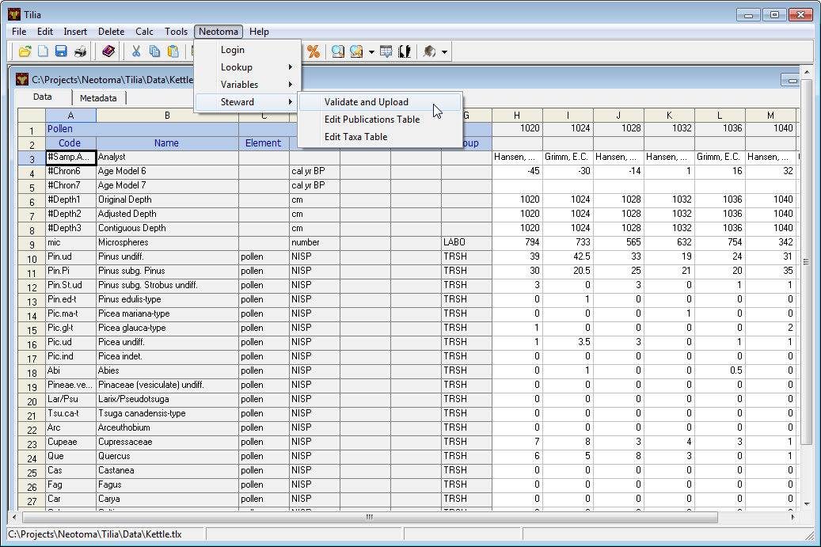
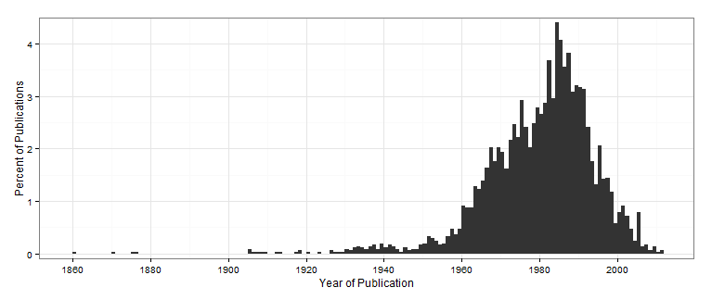
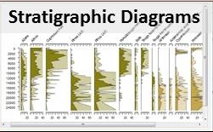
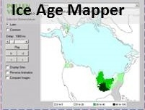
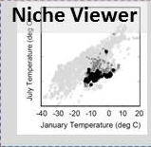
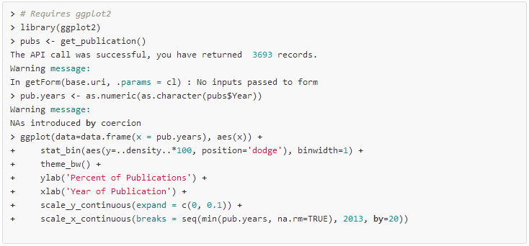
Neotoma Informatics Ecosystem
Data Exploration and Retrieval
Data Upload and Download
Neotoma Explorer
Tilia
API
Web Services
Neotoma
DB
Data Retrieval and Analysis
neotoma package for R
Data Visualization

Slide 33
New Initiatives
Expanding to accommodate other data types: isotopes, biomarkers,…
Accommodating specimen level data
Forging links with other databases: NOAA Paleo, Paleobiology Database, GBIF,…
Issuance of DOI’s
Establishment of embargo capability
Workshops: EPD, Linked Paleodata, C4P Hackathon, AmQua, ESA, SVP, IBS

Slide 34
www.neotomadb.org
Thank you!

